Slide 1


HCI - Assignment 1
2024/2025
ClearVue
“Making you days clearer since 2025”
Presented by:
Edivaldo Bonfim
Mateus da Fonte
Date Presented:
March 11th, 2025

Slide 2
Problem Being Addressed
Problem
Difficulties in purchasing eyewear online (sizing issues, inability to try on, unavailability of buying specific personalized lenses)
Affected Users
People needing prescription glasses, fashion-conscious consumers, overwhelmed professionals with neglected eye health
Current Status
High return rates and low customer confidence in online eyewear shopping
Project Selection
Creating an integrated e-commerce solution for opticians that offers personalized shopping experiences with virtual try-on and prescription management

Slide 3
Objectives
01
02
03
Increase customer confidence in online eyewear purchases
Create an intuitive optical e-commerce platform with virtual try-on capabilities
Simplify prescription upload and management

Slide 4
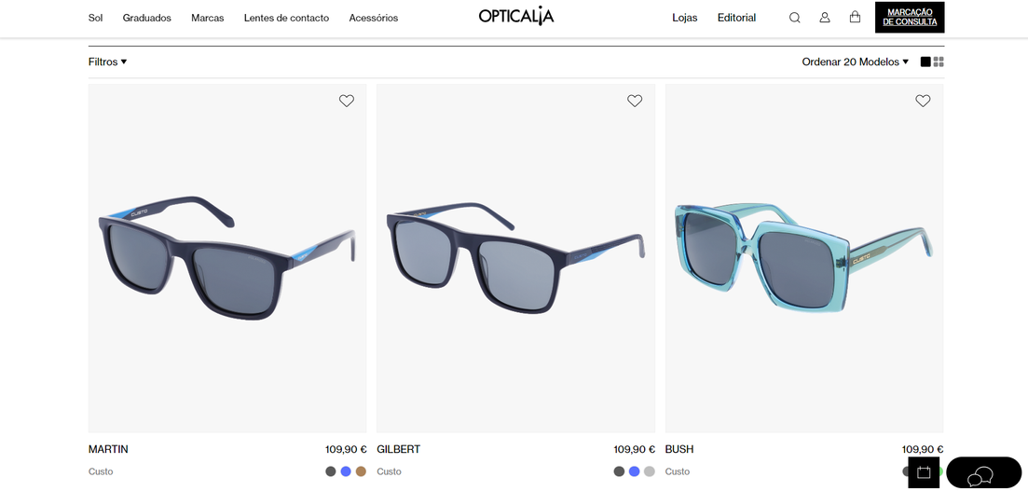
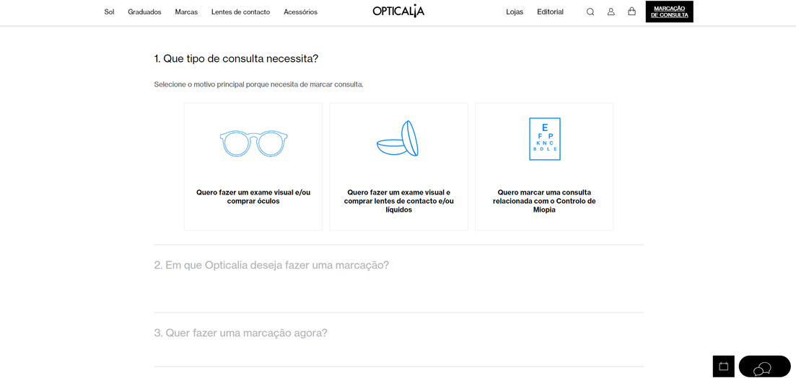
Competitor Analysis - Opticalia
Opticalia is an optical retail company that sells eyeglasses, sunglasses, contact lenses, and other vision-related products.
They operate multiple retail locations throughout Portugal.
They offer vision testing services and eyewear prescriptions.
As a retail optical chain, they carry various brands of frames and lenses.

Slide 5
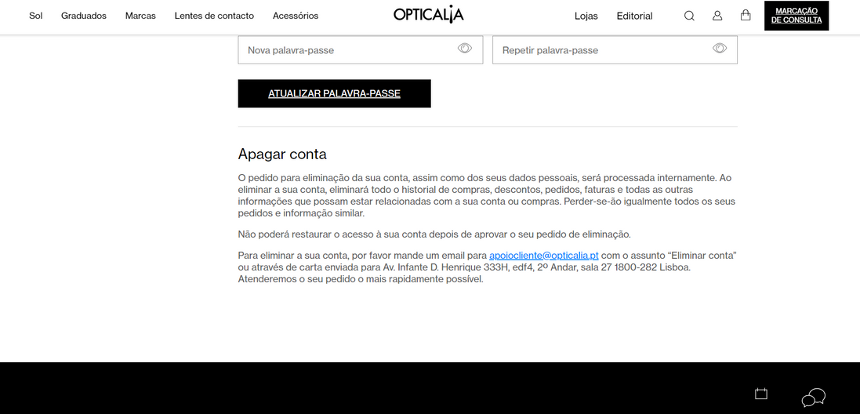
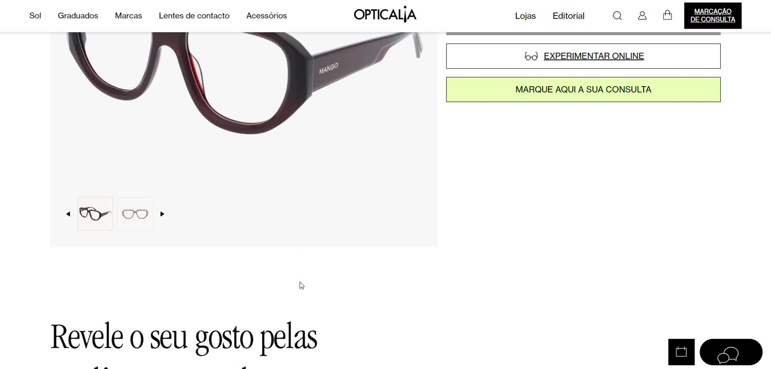
Competitor Analysis - Opticalia
Website Issues
Spanish translation problems throughout the site
"Add to Cart" button is non-functional
Guest checkout option exists but lacks clear explanation of guest user limitations
No feedback message when attempting to complete purchase as a guest (e.g., "Registration/login required")
Unable to add items to cart while browsing as a guest user

Slide 6
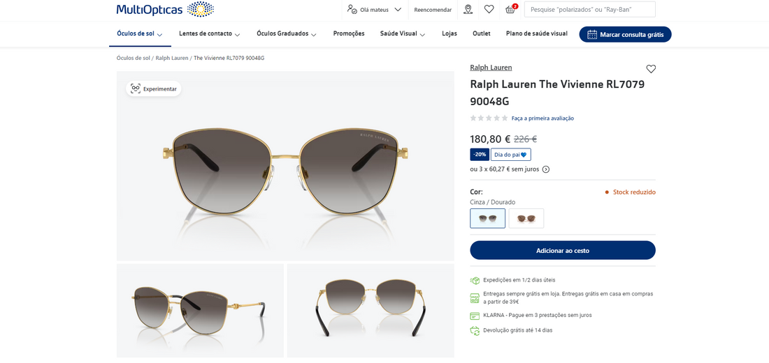
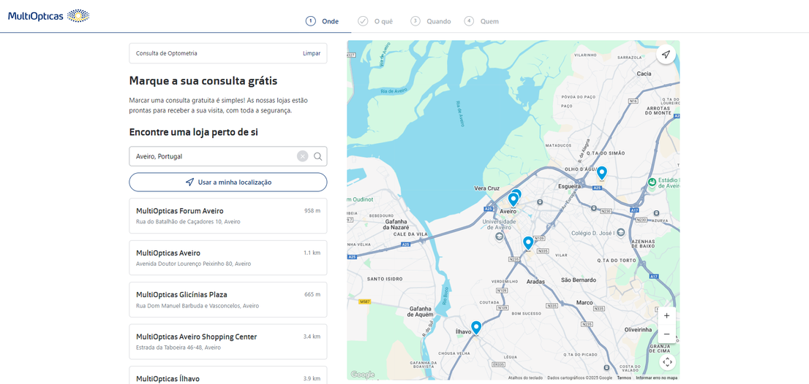
Competitor Analysis - MultiOpticas
MultiOpticas is one of Portugal’s largest optical retail chains, offering a wide range of eyewear products and vision care services.
Sells prescription glasses, sunglasses, contact lenses, and optical accessories.
Provides eye exams, vision consultations, and personalized lens fitting.
Operates numerous physical stores across Portugal while also providing an online shopping experience.

Slide 7
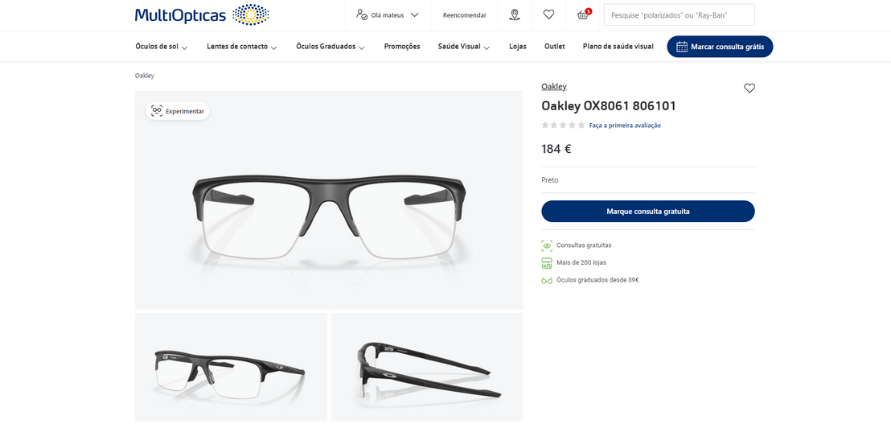
Competitor Analysis - MultiOpticas
Website Issues
Inability to purchase prescription eyeglasses online using an existing prescription, requiring the scheduling of an in-person eye exam instead

Slide 8
Methods used to analyse the main competitor Opticalia
Purchases online,
Appointments for consultations.
Test the glasses virtually.

Slide 9
Methods
Heuristic Evaluation Method
We evaluated the Opticalia website based on Nielsen's 10 heuristics
Method for cognitive walkthrough
We simulate common tasks, like adding an item to the cart, to identify points of confusion

Slide 10
Heuristic Evaluation
 | Mateus | Edivaldo | Recommendation
Lack of feedback when adding an item to the cart (as a guest or logged in). | 4 | 4 | Provide a clear error message explaining why the item cannot be added to the cart.
There is no feedback when clicking the "Checkout" button as a guest. | 5 | 4 | Add a clear message informing the user that they need to register or log in to complete the purchase.
Translation problems into Spanish (Spanish phrases and words). | 4 | 3 | Review and correct translations to ensure consistency in the user's chosen language.

Slide 11
 | Mateus | Edivaldo | Recommendation
"Continue as Guest" button does not explain the limits of this option. | 3 | 3 | Add a clear explanation about the limitations of purchasing as a guest.
Unable to add products to cart even after logging in. | 5 | 4 | Fix the technical issue and ensure the cart works properly after login.
To create an account, you need to add a store. | 4 | 3 | Simplify the registration process by removing the requirement to add a store.
Interface can be confusing due to functionality issues. | 3 | 2 | Simplify the interface and ensure all functionality is working properly.

Slide 12
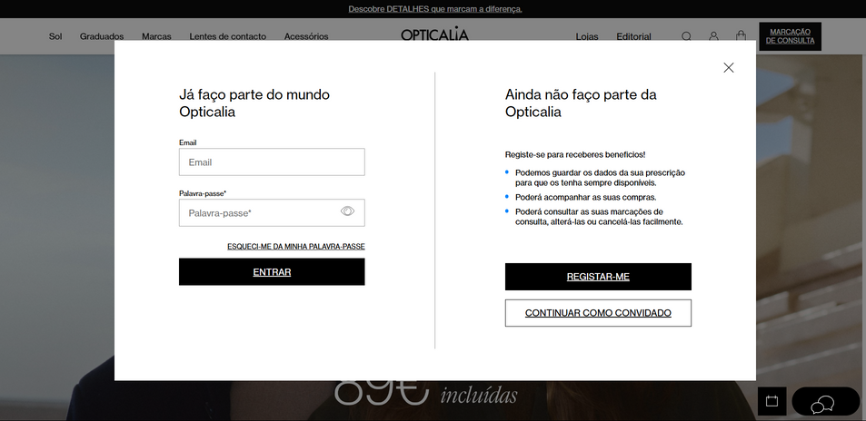
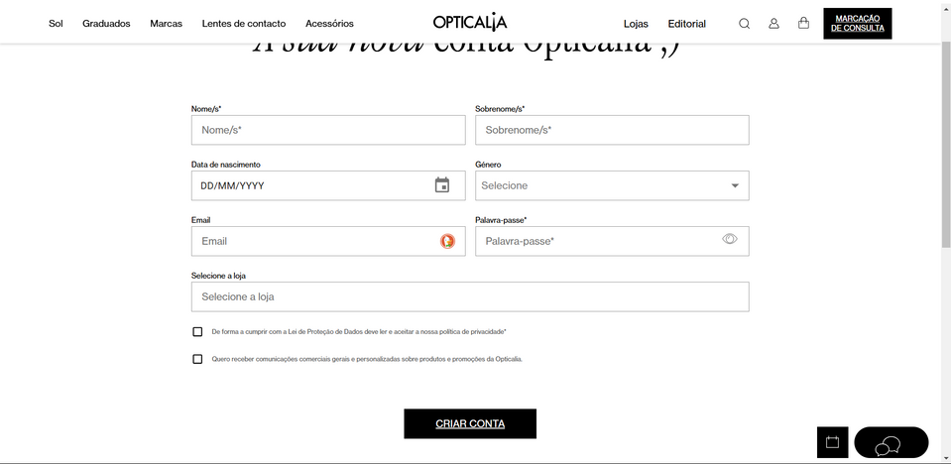
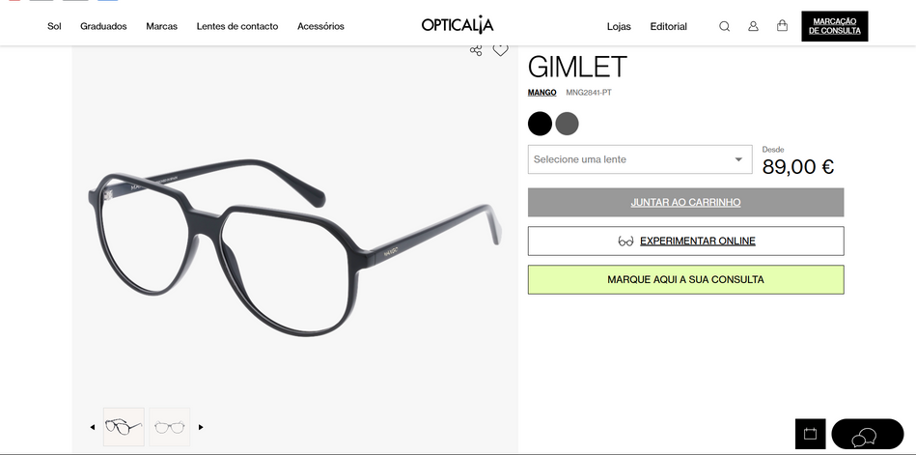
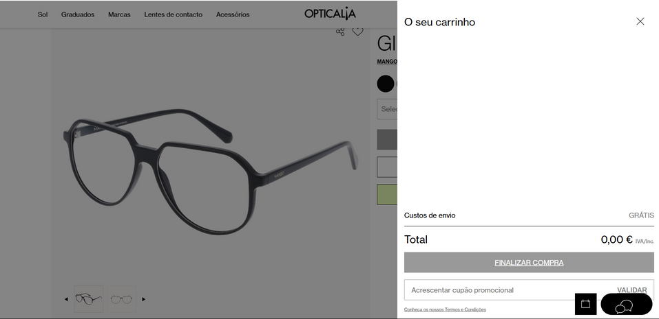
Heuristic screenshots

Slide 13
Understing Users
Customer Profile
Purchase cycle: Every 2-3 years, strong preference for physical stores,
no online eyewear purchase experience.
Online Requirements
Virtual try-on is essential. Key info: aesthetics, price, technical specs, prescription compatibility.
Decision Factors
Reviews highly influential, transparent pricing, real people wearing the products.
Services
Mixed interest in online eye exam booking, quick support expected.
Loyalty
Positive reception to loyalty, Desire for personalized offers with frequency control.

Slide 14
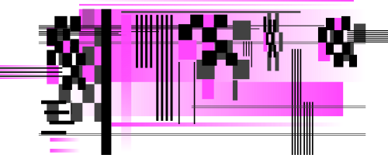
Personas

Slide 15

About the User
Motivations
João started wearing glasses in university. He's tech-savvy and comfortable with online shopping for most products, but has only purchased eyewear in physical stores. He's open to trying new shopping methods if they offer convenience without compromising quality.
Finding modern, minimalist frames that suit his style
Convenience and time-saving shopping options
Technical information about products
Value for money with loyalty benefits
Behaviors
Researches products thoroughly online
Price-conscious but willing to invest in quality
Reads multiple reviews before making decisions
Updates his eyewear primarily when his prescription changes
Values efficiency in shopping experiences
Goals/Needs
João Santos
Easy-to-use virtual try-on technology
Detailed technical specifications about frames and lenses
Ability to upload his prescription securely
Flexible customer service options including chat
Personalized recommendations based on face shape and style
28 years old
Male
IT Developer
Lives in Porto, Portugal
Pain Points
Worried about accuracy of online prescriptions
Concerned about the return process if glasses don't fit properly
Dislikes frequent marketing communications
Limited time for in-person shopping appointments

Slide 16

About the User
Motivations
Maria has been wearing prescription glasses for over 20 years. She purchases new frames every 2-3 years, usually when her prescription changes or when she wants to update her style. She values quality and durability but is also conscious about price.
Finding stylish frames that suit her face shape
Ensuring comfort for all-day wear
Getting good value for money
Maintaining a professional appearance while expressing personal style
Behaviors
Shops exclusively at physical optical stores
Researches options online before visiting stores
Relies heavily on reviews and recommendations
Prefers to try on multiple frames before deciding
Concerned about how glasses complement her professional appearance
Goals/Needs
Maria Oliveira
Convenient way to browse options before visiting a store
Ability to visualize how frames would look on her face
Clear information about frame materials, weight, and durability
Transparent pricing including lens options
Expert advice on which frames suit her face shape
42 years old
Female
Marketing Manager
Lives in Lisbon, Portugal
Pain Points
Skeptical about purchasing eyewear online without trying it on
Concerned about fit and comfort when shopping online
Limited time to visit physical stores during business hours

Slide 17
User Scenarios

Slide 18
Scenario 1: Maria's Replacement Glasses
Motivations
Persona: Maria Oliveira
User Journey
Maria has been wearing the same pair of glasses for almost three years. Last week, while cleaning her glasses, she noticed a crack in one of the lenses. Since she has an important client presentation next week, she needs to get a replacement pair quickly. However, her schedule is packed with meetings during normal business hours, making it difficult to visit a physical optical store.
Maria remembers she has her prescription from her eye exam six months ago
During her lunch break, she visits the optical website on her desktop computer
She searches for frames similar to her current style, filtering by women's frames and professional appearance
She uploads her existing prescription via the prescription management tool
She uses the virtual try-on feature to see how different frames would look on her face
She reads reviews from other customers about frame durability and comfort
She selects a frame and completes her purchase, choosing express delivery
She receives confirmation that her glasses will be ready in 3-5 business days
Key Needs
Ability to shop outside of business hours
Easy prescription upload
Virtual try-on capability
Clear delivery timeframes
Professional-looking frames for work environment

Slide 19
Scenario 2: João's First Online Eyewear Purchase
Motivations
Persona: João Santos
User Journey
João's prescription has changed, and he needs new glasses. As a tech-savvy person who regularly shops online for other products, he's considering trying an online optical shop for the first time, but he has concerns about getting the right fit and quality without trying frames on in person. He wants to explore options during evening hours when he has free time.
João browses the website on his smartphone after dinner
He uses the face shape analyzer tool to determine his face shape
He filters frames by face shape compatibility, material (lightweight titanium), and minimalist style
He uses the virtual try-on feature to visualize several options
He has questions about lens thickness for his high prescription and initiates a WhatsApp chat with customer support
After receiving answers, he selects a frame but saves it to his wishlist to consider overnight
The next day, he returns to complete the purchase, entering his prescription details manually
He selects the option for frame adjustment at a local partner optical shop if needed
Key Needs
Mobile-optimized shopping experience
Technical specifications about materials and weight
Expert advice about lens options for strong prescriptions
Flexible support options during evening hours
Confidence in return/adjustment policies

Slide 20
Requirements

Slide 21
Requirements and Proposed Solution
Make a purchase online
Schedule eye exams
Blog for eye information
Prescription Integration
Virtual Try-on - Personalizate
Glasses recycling
Add favorite
Clear user feedback

Slide 22
Evaluation and Next Steps

Slide 23
What Went Right and What Went Wrong
01
User interviews brought valuable insights.
02
Detailed analysis of competitors.
03
Difficulty testing broken features on the Opticalia website.
04
Time constraints to interview more users.
05
Clear identification of Opticalia's usability problems.

Slide 24
Next steps
1
2
3
Solution prototyping
Perform usability testing with prototypes.
. . .

Slide 25

Group Assessment

